Slide 1

Master’s Thesis: Digital Transformation of Small and Medium Enterprises, historical development and trends
Aidyn Kudamanov
Czech University of Life Sciences, Prague | EXEN1Z
Department of Information Technologies
Ing. Martin Lukáš, Ph.D.

Slide 2
Introduction
SME = power to boost economy
Target of climate neutrality by 2050 | Digital Transformation of Europe 2030
Historical Development of Nordic countries
DT transfomation frameworks for SME
TOGAF approach for EA with cloud procurement solution
Digital Adoption for SME

Slide 3
Objectives
Define digital trends status of SME
Investigate the influence of Digital Transformation
Propose solutions/workarounds fof non-digital SME challenges
Construct digital transformation template for SME

Slide 4
Methodology
Study of scholarly and professional literature
Descriptive analysis of SME within EU landscape
Interpret the case study using Archimate with TOGAF approach
Conclude by providing the recommendations
Notes:
European Commission. (2020b, February 19). Shaping Europe’s digital future [Text]. European Commission - European Commission. https://ec.europa.eu/commission/presscorner/detail/en/ip_20_273
European Commission. (2022, June 30). A green and digital future: 7 insights from strategic foresight - European Commission. https://joint-research-centre.ec.europa.eu/jrc-news-and- updates/green-and-digital-future-7-insights-strategic-foresight-2022-06-30_en
Knight, G. A. (2001). Entrepreneurship and strategy in the international SME. Journal of International Management, 7(3), 155–171. https://doi.org/10.1016/S1075-4253(01)00042-4

Slide 5
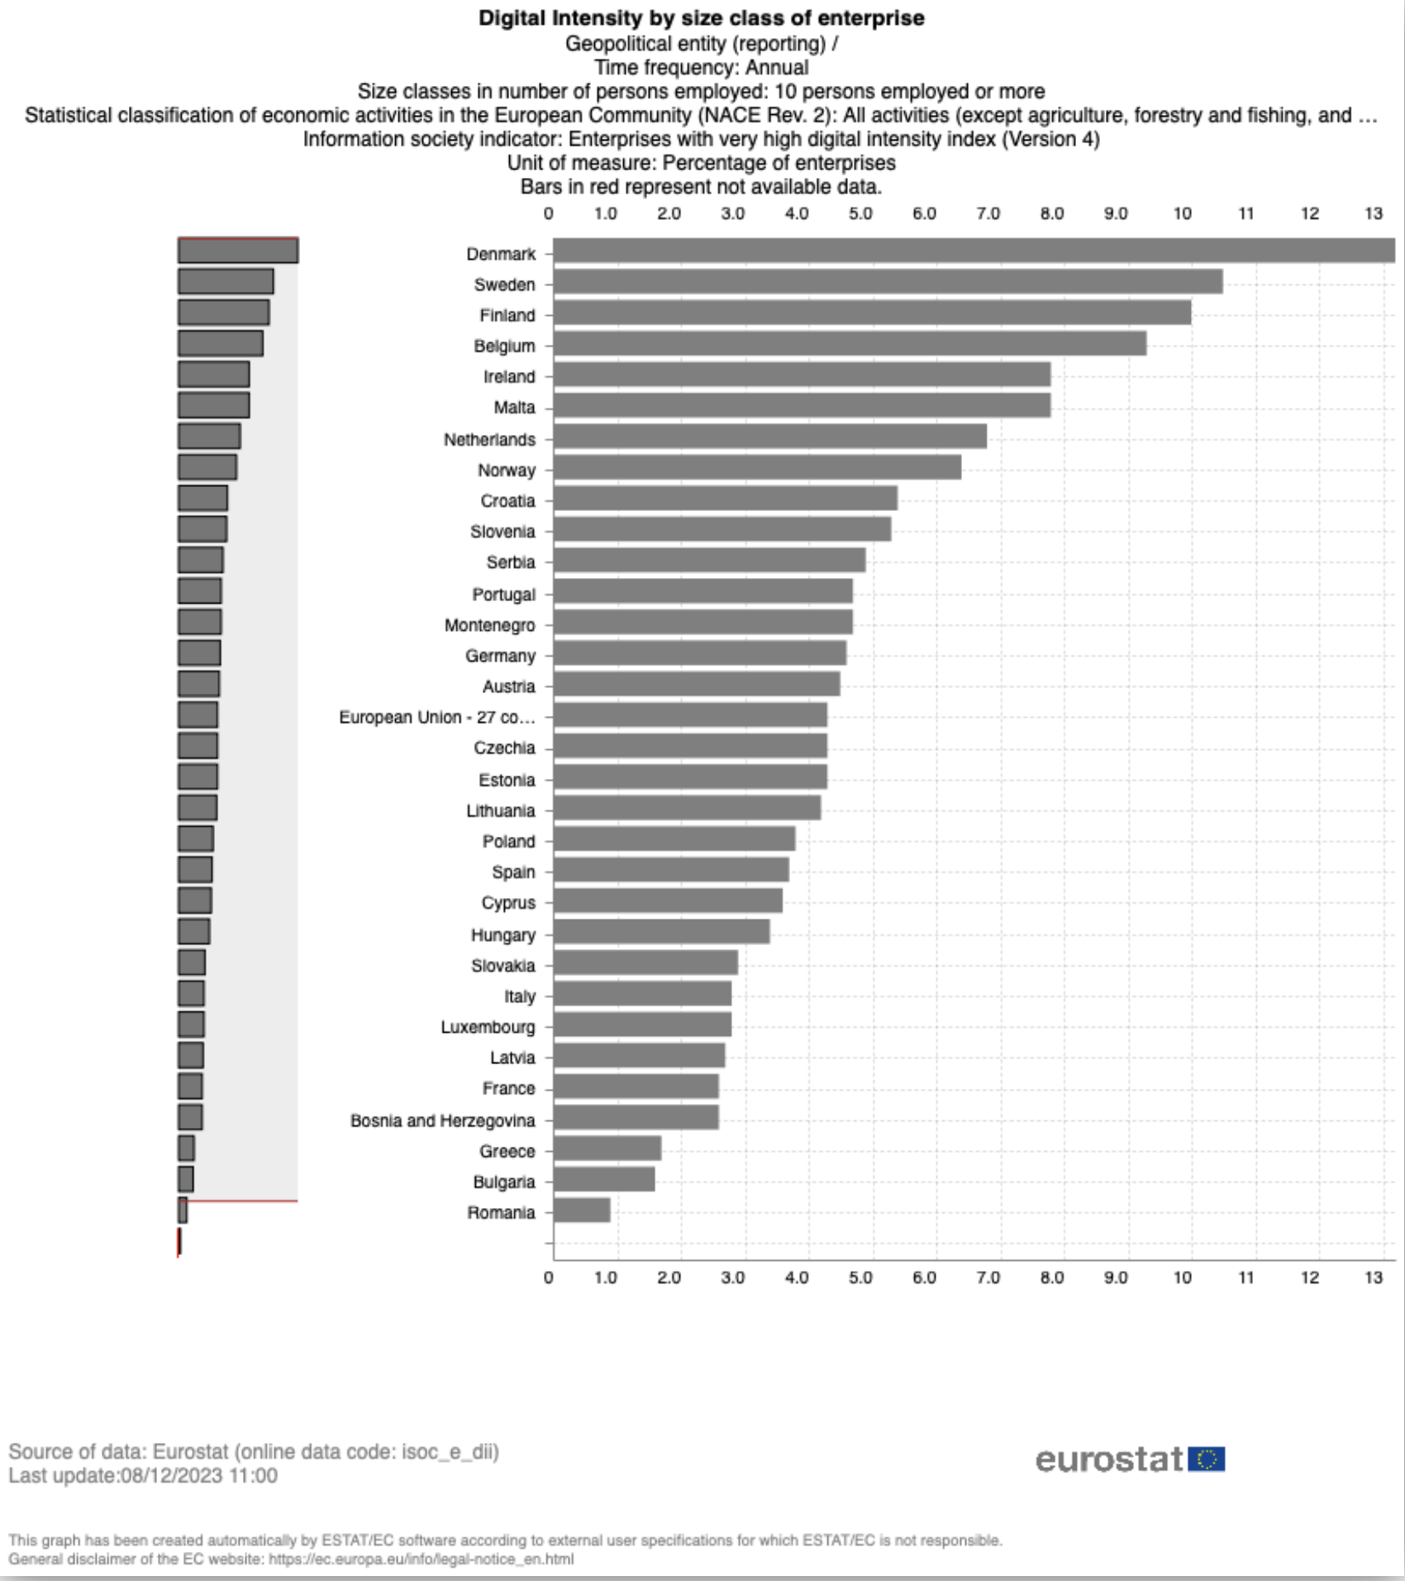
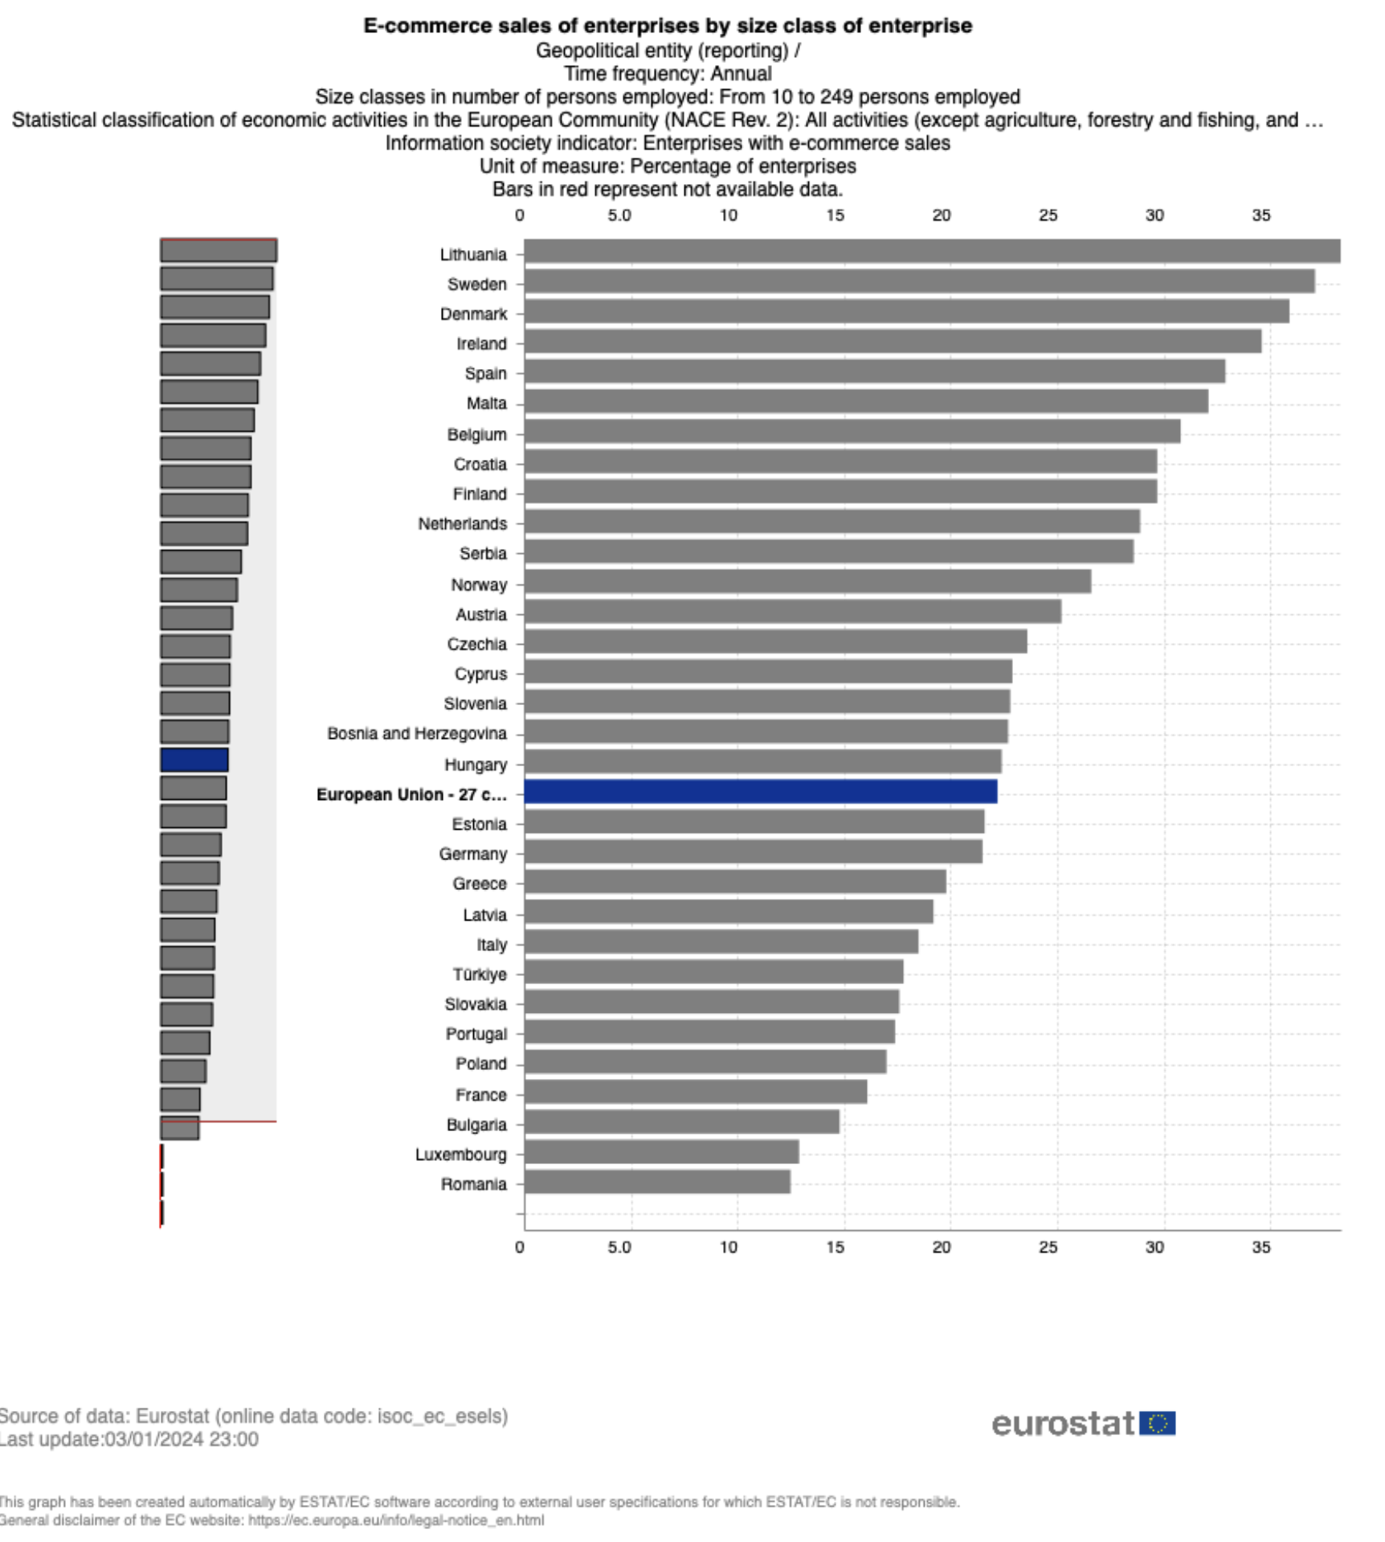
DT in EU
Digital intensity level in business, 2022 (Source: eurostat)
Business and E-sales, 2022 (source: eurostat)

Slide 6
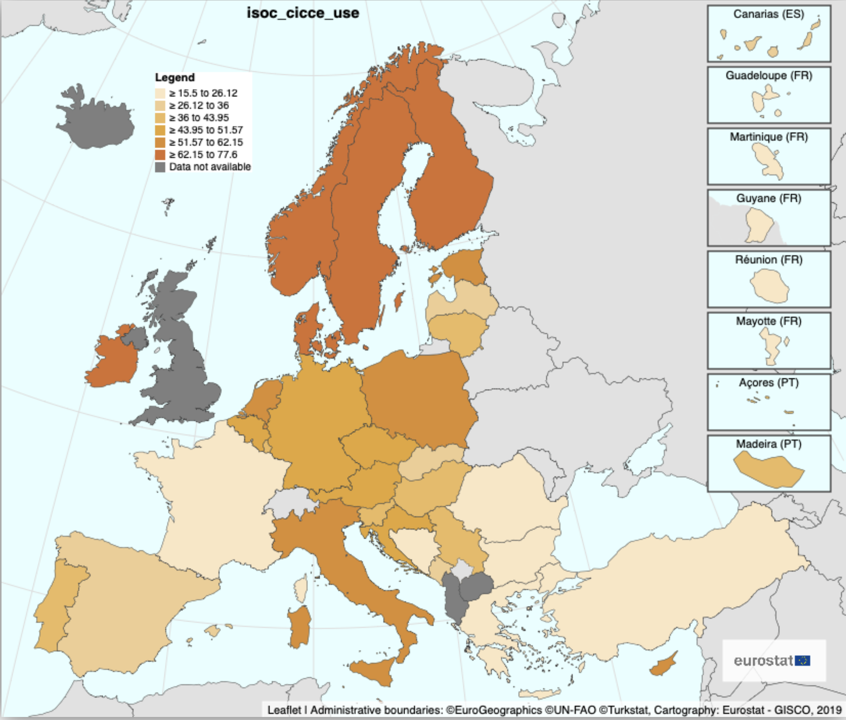
DT in EU
Businesses purchase cloud computing solutions, 2021 (source: eurostat)

Slide 7
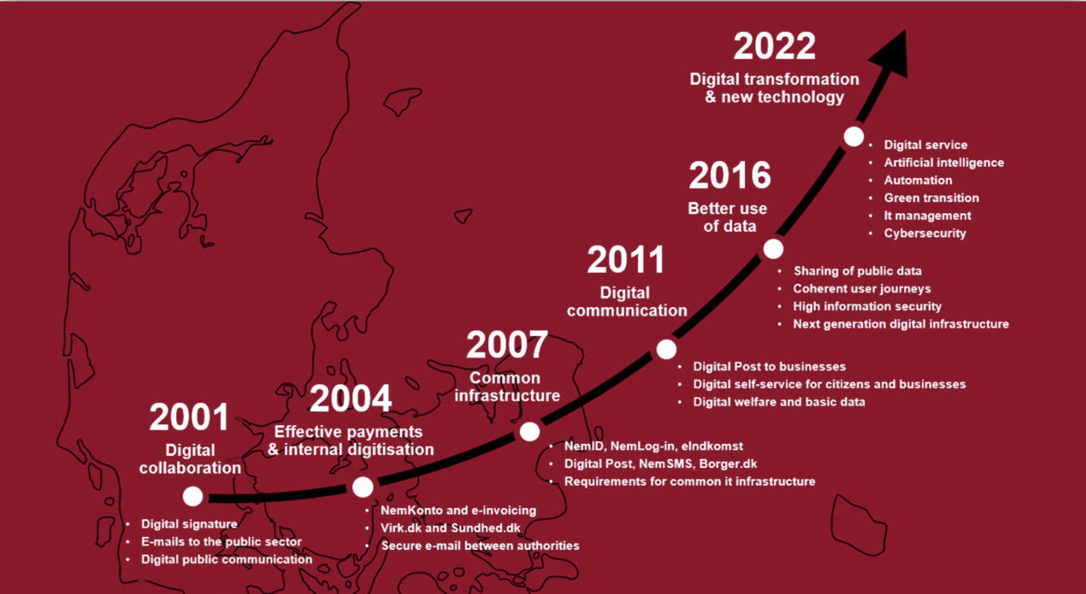
Historical Development of Nordic Countries
Governmental action
Early adoption of digital technologies
Robust internet and mobile infrastructure
Digital Evolution of Denmark (source: Agency of Digital Government, 2024)
Notes:
Parmiggiani, E., & Mikalef, P. (2022). The Case of Norway and Digital Transformation over the Years. Springer. https://ntnuopen.ntnu.no/ntnu-xmlui/handle/11250/3025549
The Danish Digital Journey. (n.d.). from https://en.digst.dk/policy/the-danish-digital-journey/

Slide 8
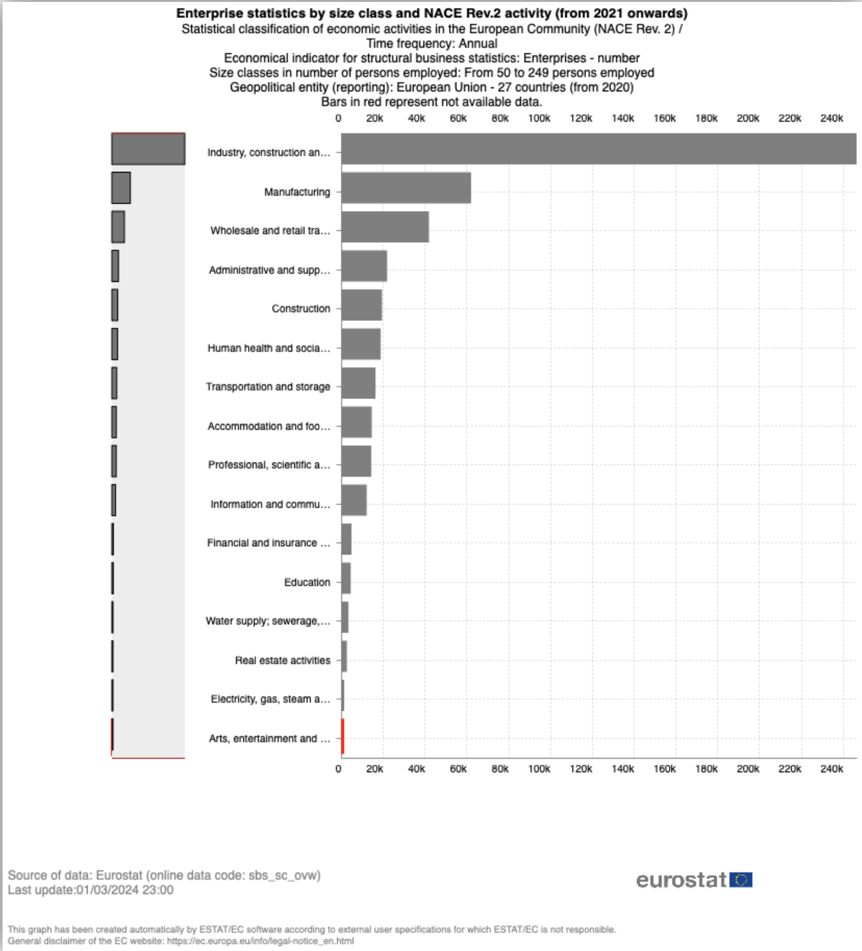
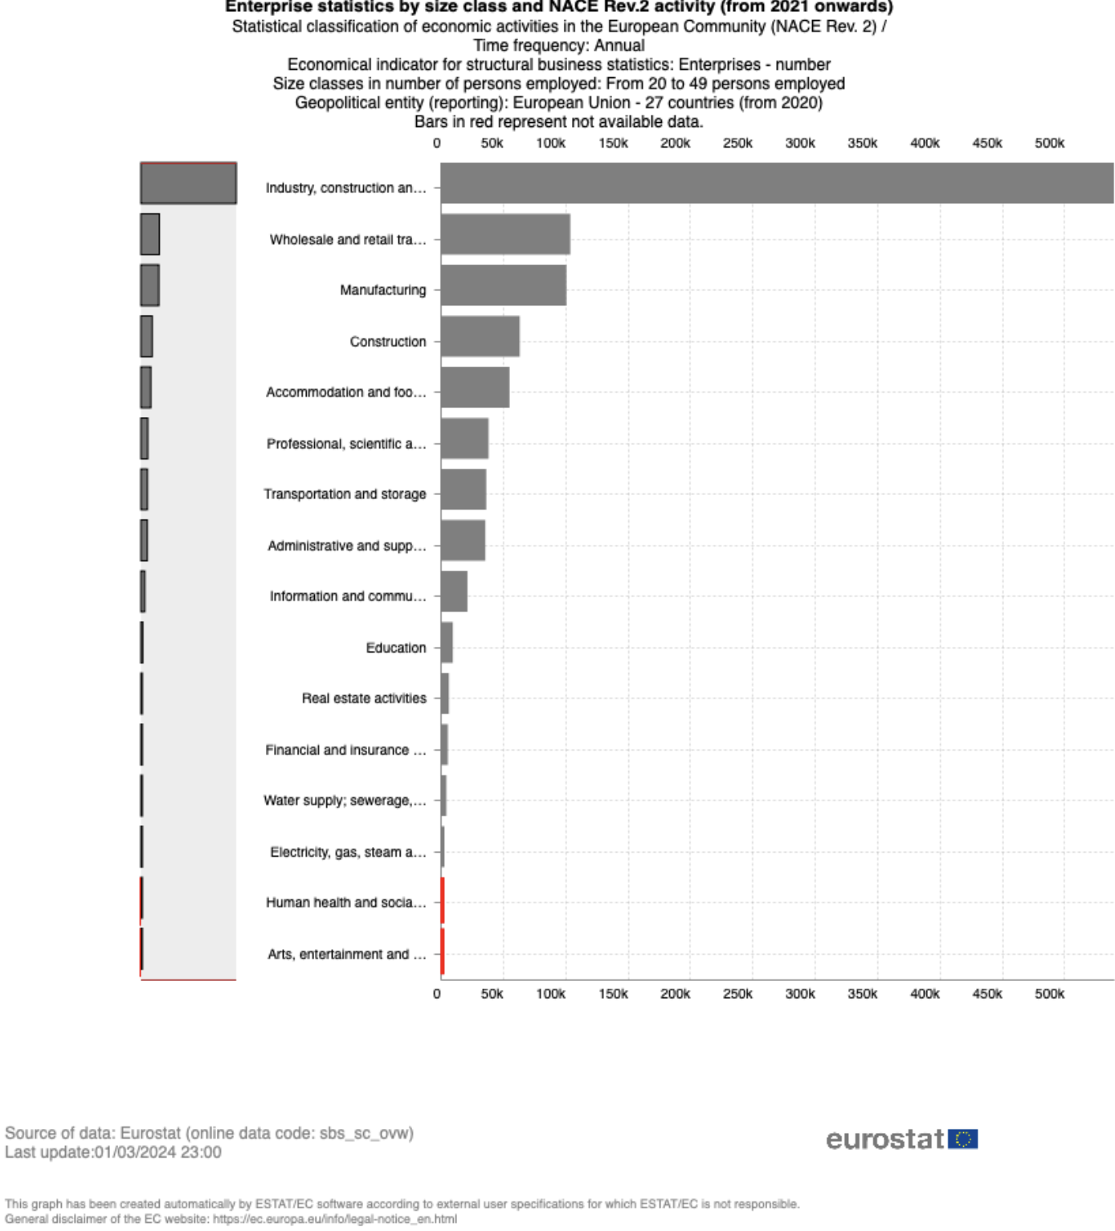
DT and Multiple sectors
Number of enterprises in the field sectors for the employment between “20 and 49”; “50 and 249” for years 2021, 2022 (source: eurostat)

Slide 9
DT and Multiple sectors
Industrial Sector
Automation
Data acquisition
AI
Manufacturing Sector
Automation
Robotics
Wholesale and Retail Sector
Digital sales channels
E-commerce
Notes:
Abdallah, Y., Shehab, E., & Al-Ashaab, A. (2021, August 31). Digital Transformation Challenges in the Manufacturing Industry. https://doi.org/10.3233/ATDE210004
ECSO. (2021). Digitalisation in the construction sector [Executive Summary].
Etminan, G., Peters-Anders, J., STOLWIJIK, C., SEBASTIAN, R., REZVANI, S., ARTOLA, I.,
SAHEB, Y., TRAUNMULLER, M., & Hatami, F. (2019). Supporting digitalisation of the construction sector and SMEs Including Building Information Modelling EUROPEAN COMMISSION LEGAL NOTICE. https://doi.org/10.2826/422658 McKinsey & Company & EuroCommerce Retail & Wholesale. (2022). Transforming the EU retail & wholesale sector.

Slide 10
DT and Multiple sectors (Challenges & Solutions)
High Cost
Shortage of skilled workers
Technology adoption
Management of Change
Financing Opportunities:
Horizon Europe
Digital Europe
Support Network Initiatives:
Digital Innovation Hubs
Enteprise Europe Network
Business Opporutnies:
Digital Single Market
Notes:
Abdallah, Y., Shehab, E., & Al-Ashaab, A. (2021, August 31). Digital Transformation Challenges in the Manufacturing Industry. https://doi.org/10.3233/ATDE210004
ECSO. (2021). Digitalisation in the construction sector [Executive Summary].
Etminan, G., Peters-Anders, J., STOLWIJIK, C., SEBASTIAN, R., REZVANI, S., ARTOLA, I.,
SAHEB, Y., TRAUNMULLER, M., & Hatami, F. (2019). Supporting digitalisation of the construction sector and SMEs Including Building Information Modelling EUROPEAN COMMISSION LEGAL NOTICE. https://doi.org/10.2826/422658 McKinsey & Company & EuroCommerce Retail & Wholesale. (2022). Transforming the EU retail & wholesale sector.

Slide 11
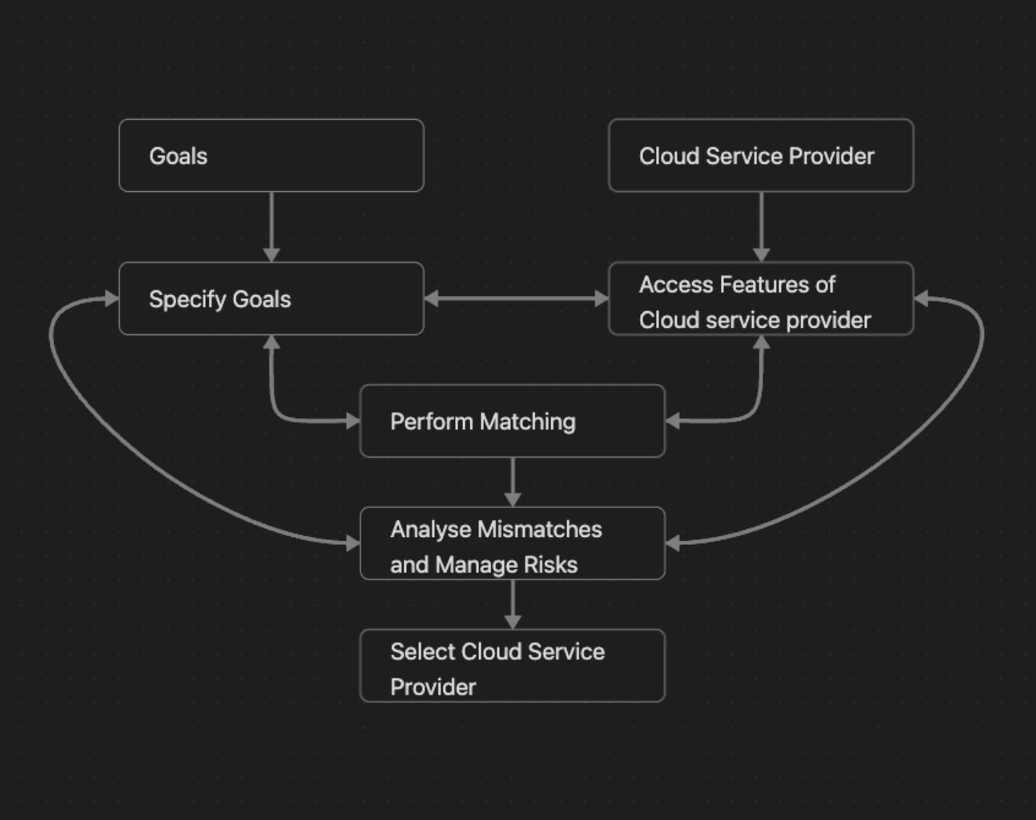
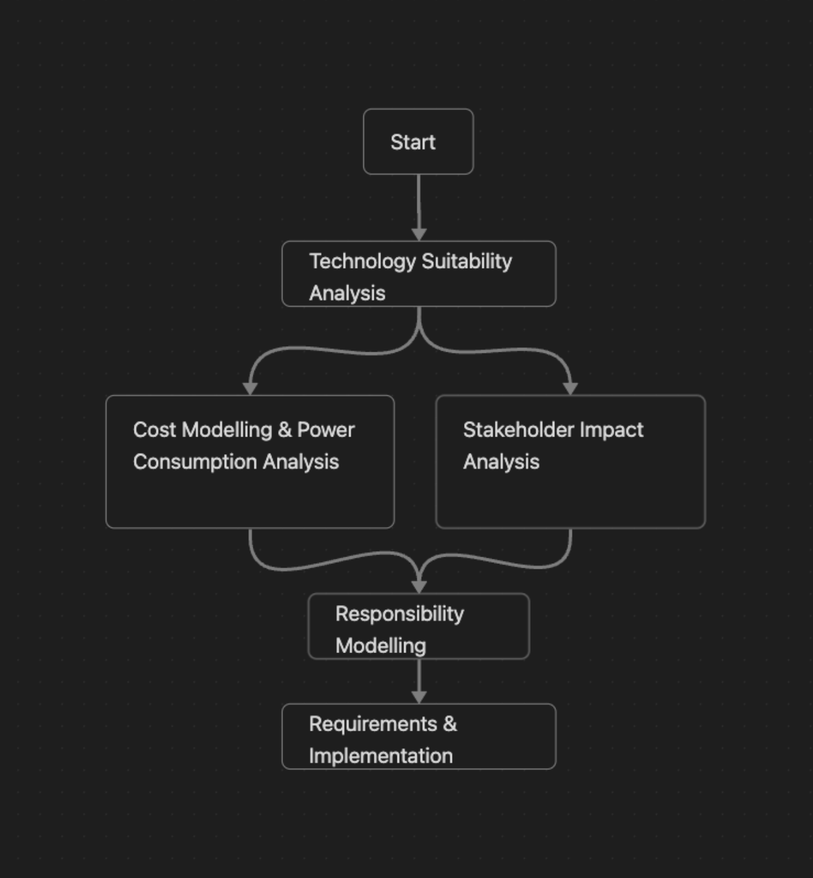
DT frameworks
Steps for cloud adoption (Source: Zardani 2011)
Cloud Adoption Toolkit (source: Khajeh-Hosseini et al., 2010
Notes:
Khajeh-Hosseini, A., Greenwood, D., Smith, J., & Sommerville, I. (2010). The Cloud Adoption Toolkit: Addressing the Challenges of Cloud Adoption in Enterprise.
Zardari, S., & Bahsoon, R. (2011). Cloud adoption: A goal-oriented requirements engineering approach. Proceedings of the 2nd International Workshop on Software Engineering for Cloud Computing, 29–35. https://doi.org/10.1145/1985500.1985506

Slide 12
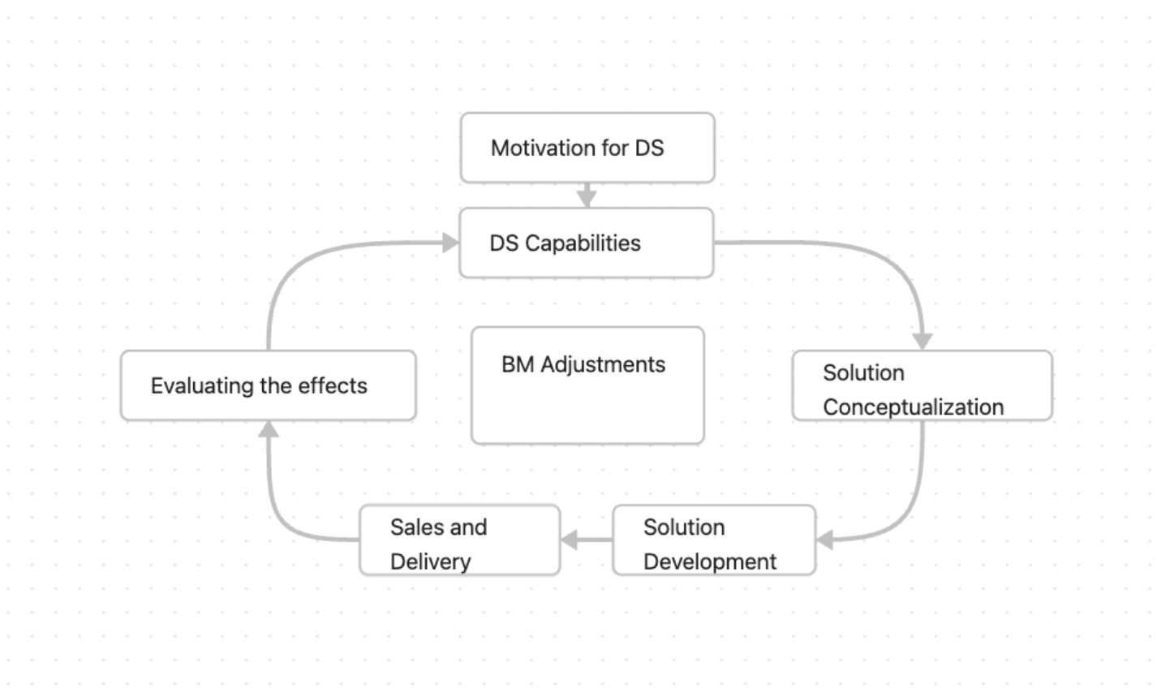
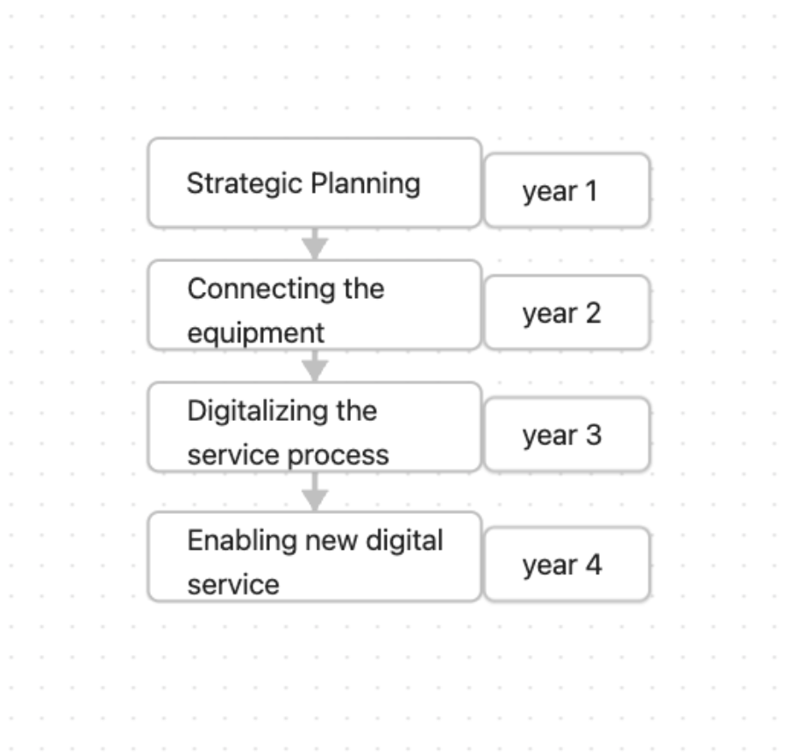
DT frameworks
Six-phase journey supportimg BMI in SMEs (source: Lamperti et al., 2024)
multi stage roadmap for DS Jorney (source: Rapaccini et al., 2023)
Notes:
Lamperti, S., Cavallo, A., & Sassanelli, C. (2024). Digital Servitization and Business Model Innovation in SMEs: A Model to Escape From Market Disruption. IEEE Transactions on Engineering Management, 71, 4619–4633. https://doi.org/10.1109/TEM.2022.3233132
Rapaccini, M., Paiola, M., Cinquini, L., & Giannetti, R. (2023). Digital servitization journey in small- and medium-sized enterprises: The contribution of knowledge-intensive business firms. Journal of Business & Industrial Marketing, 38(6), 1362–1375. https://doi.org/10.1108/JBIM-01-2022-0008

Slide 13
Case Study (1/2)
Political:
Fundings and Financial Intrsutments
Support Network Initiatives
Digital Single Market
Economical:
Operational Efficiency
Streamline operations
Reduce time and cost assosiated
Social:
Enhancement in digital skills
New roles and responsibilities
Improve transparency
Technology:
Reduce the need in on-site infrastructure
Analytical and reporting capabilities
Security concerns
Legal:
GDPR
Contract law
Environmental:
Need in paper based processes

Slide 14
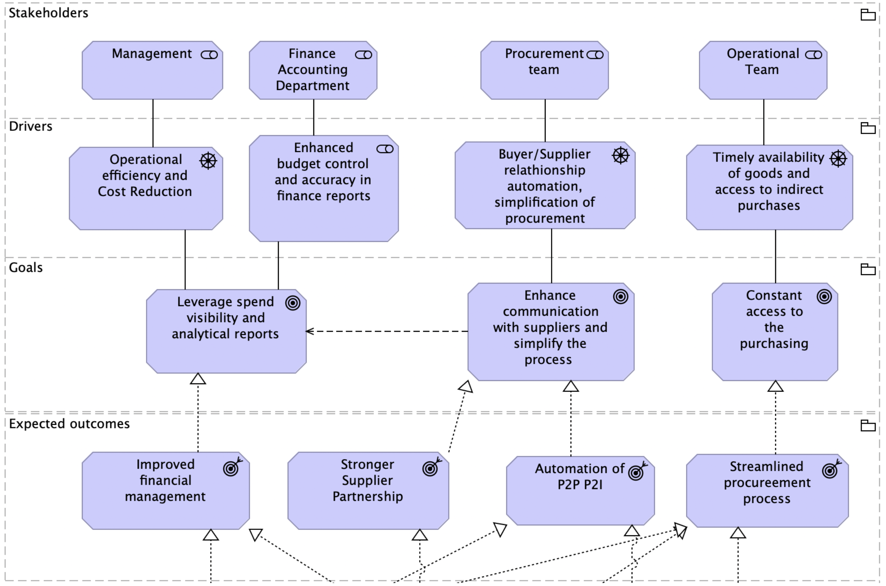
Case Study (1/2)
Motivation layer (source: own work)

Slide 15
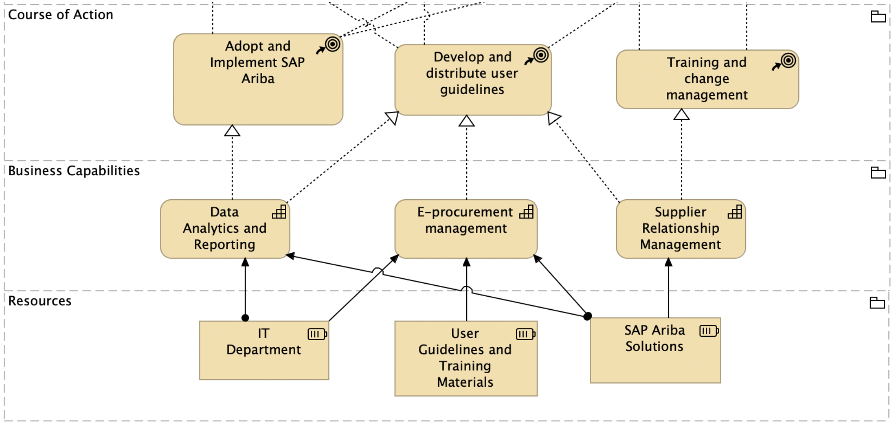
Case Study (1/2)
Strategy layer (source: own work)

Slide 16
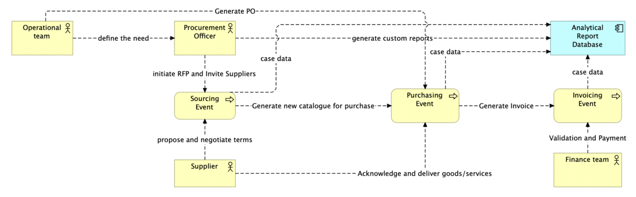
Case Study (1/2)
Business layer - cooperation view (source: own work)

Slide 17
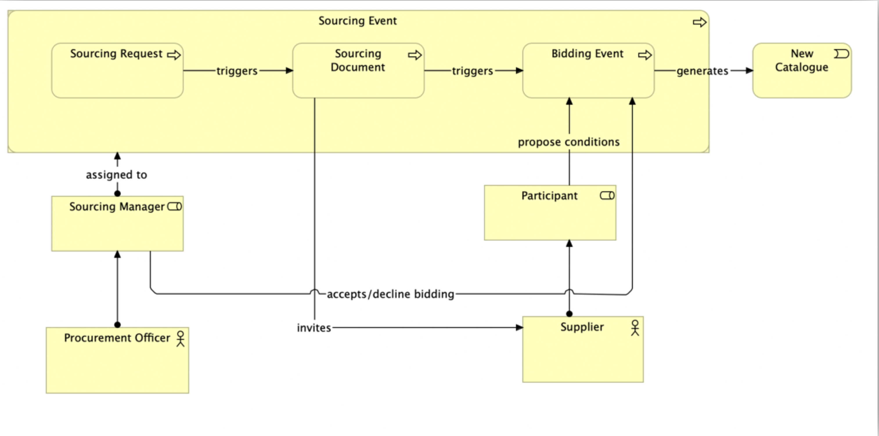
Case Study (1/2)
Sourcing Event process (source: own work)

Slide 18
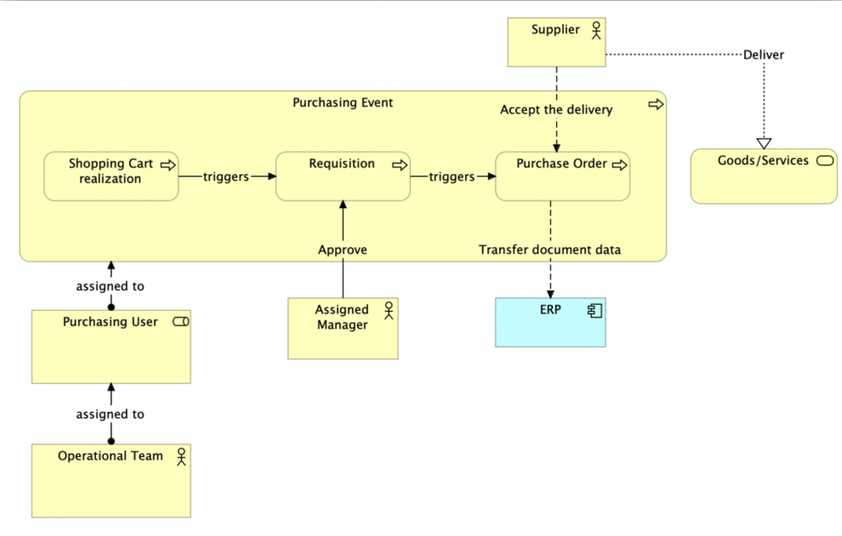
Case Study (1/2)
Purchasing Event Process (source: own work)

Slide 19
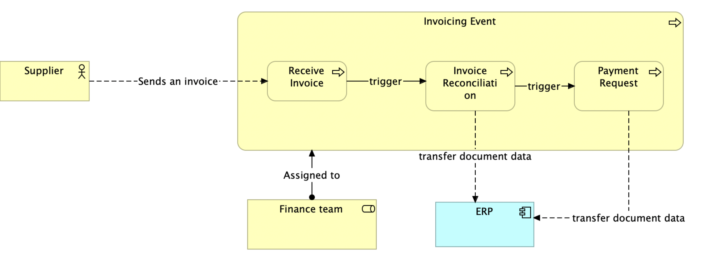
Case Study (1/2)
Invoice layer (source: own work)

Slide 20
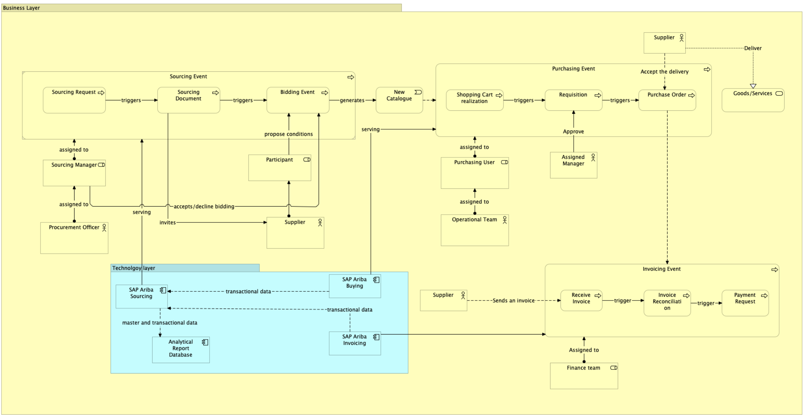
Case Study (1/2)
Business and technology layer (source: own work)

Slide 21
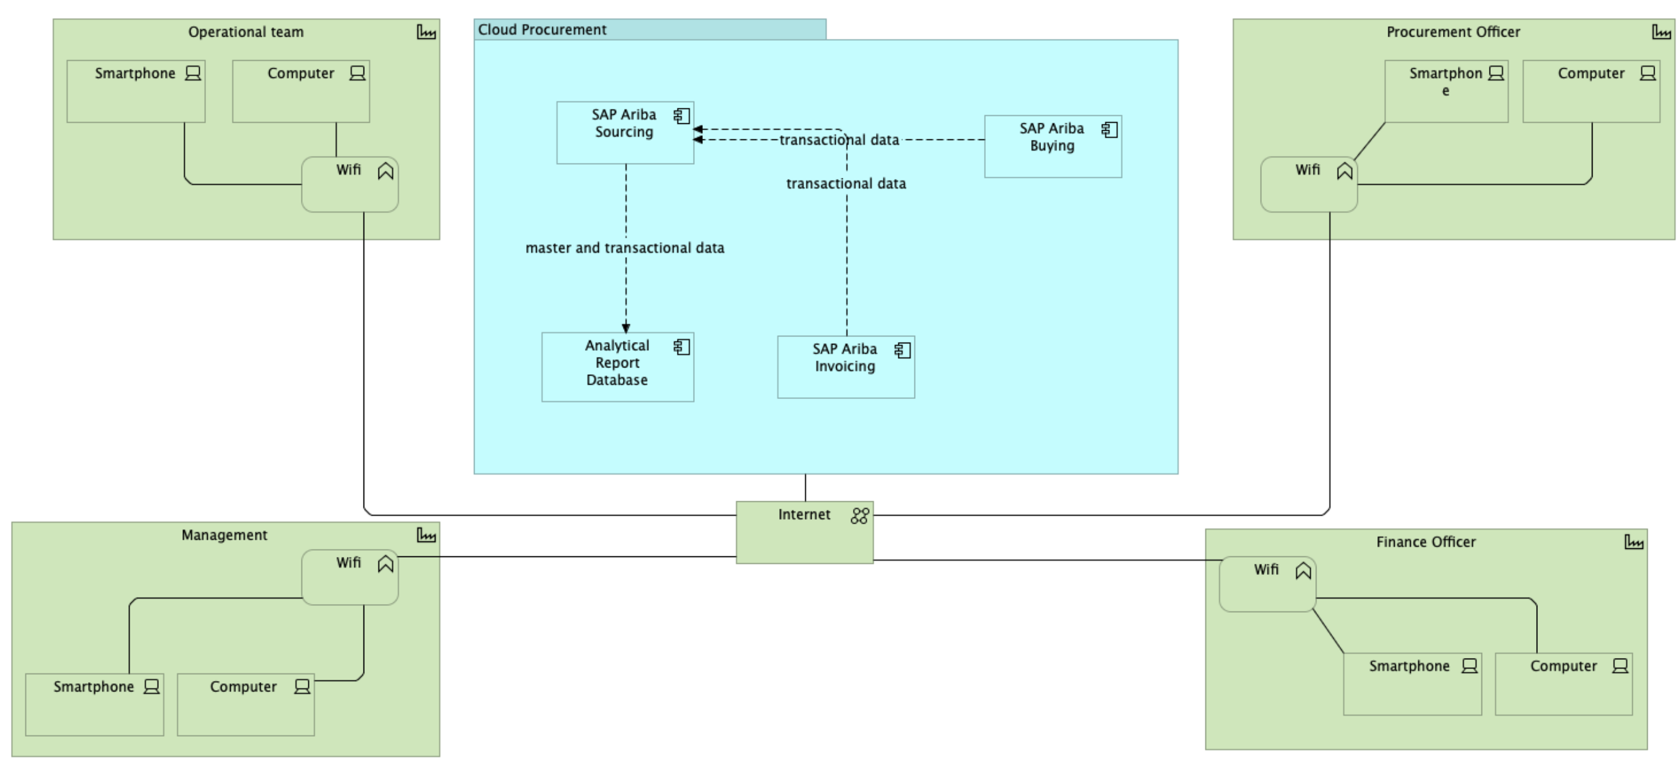
Case Study (1/2)
Technology communication layout (source: own work)

Slide 22
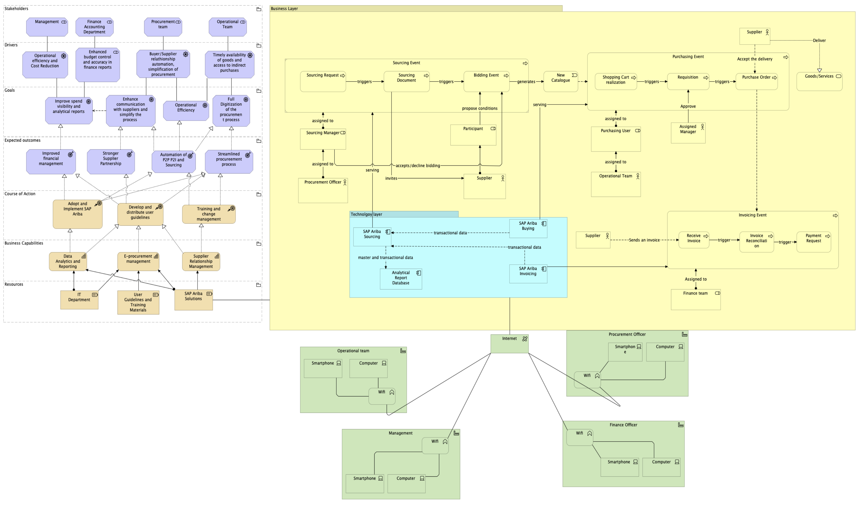
Case Study (1/2)
Combination of layers (source: own work)

Slide 23
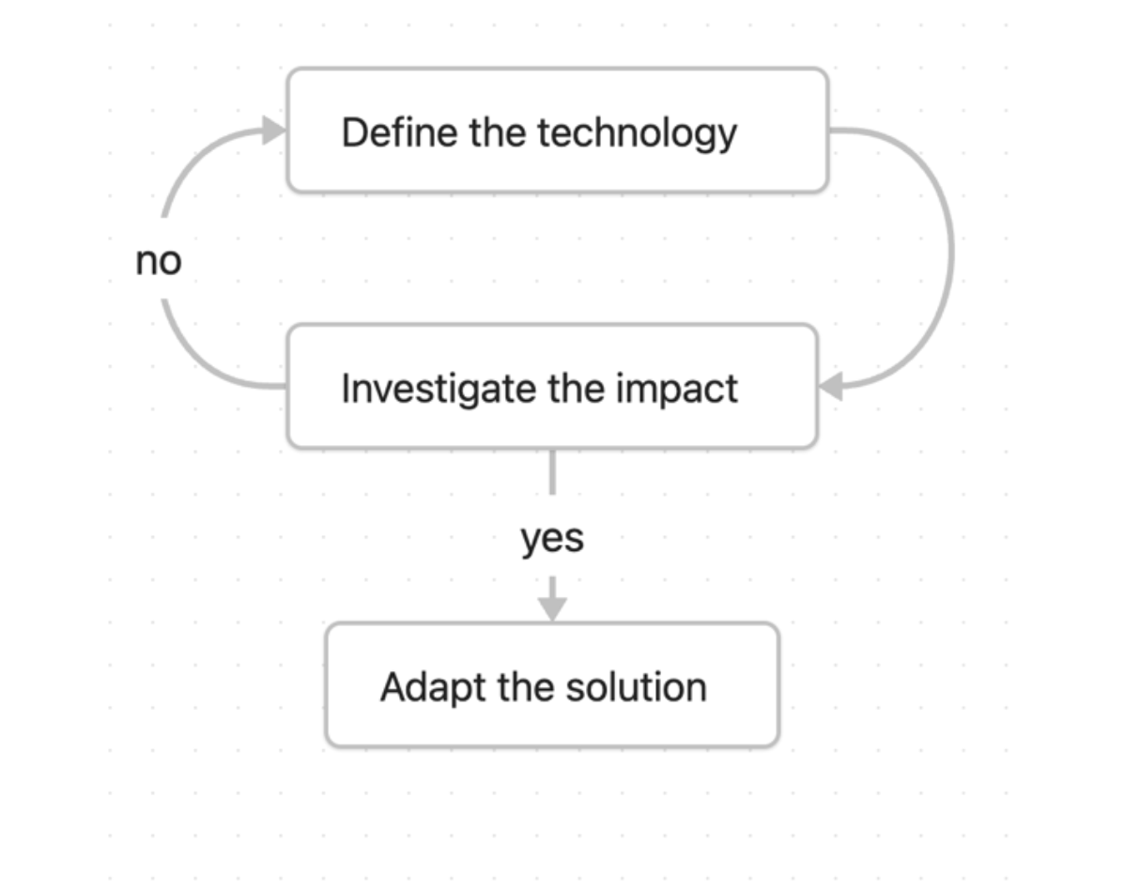
Case Study (2/2)
Technology Review (source: own work)

Slide 24
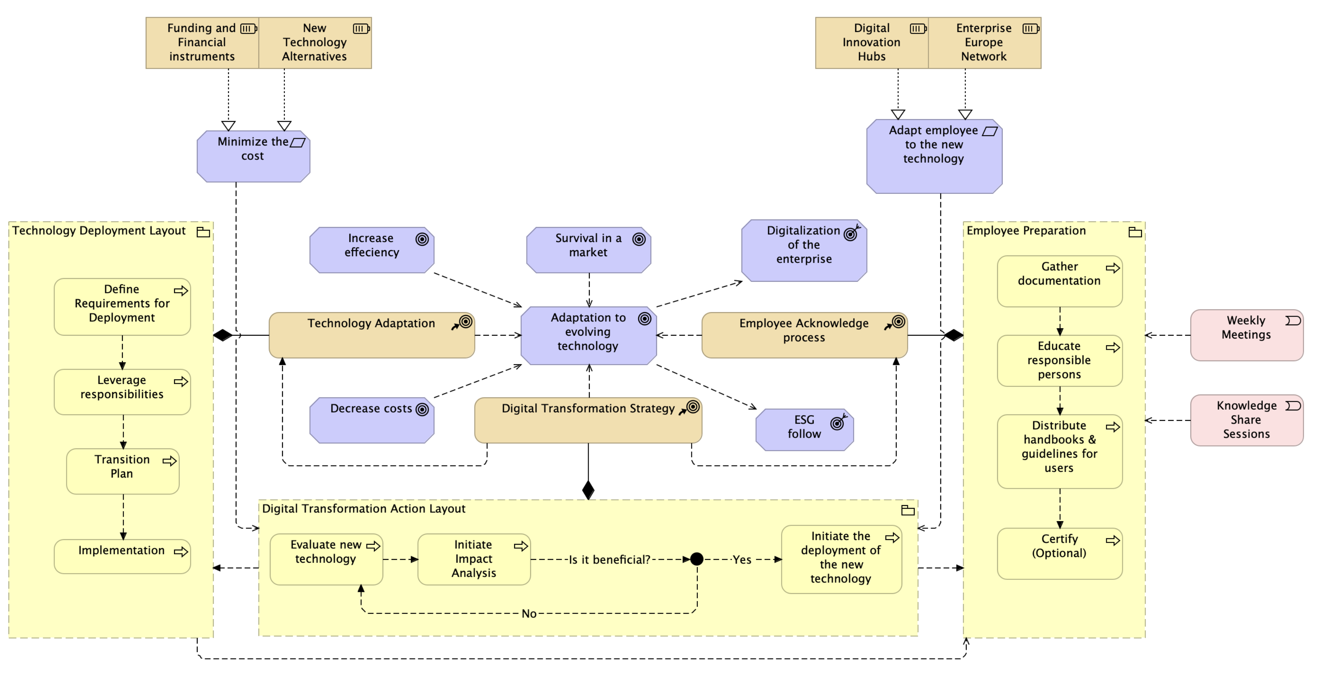
Case Study (2/2)
Digital Adoption for SME (source: own work)

Slide 25
Discussion
SAP Ariba and Digital Single Market
Nordic sample and governmental activities
EA applicability for SME
High costs barriers
People adaptability

Slide 26
Conclusion
Does SME need to invest in the new technology if better alternative may appear in the future?
Does SME need an EA if digital technology can be “easy-to-go” adapted?
Human Adaptability as one of the main problems

Slide 27
References
Abdallah, Y., Shehab, E., & Al-Ashaab, A. (2021, August 31). Digital Transformation Challenges in the Manufacturing Industry. https://doi.org/10.3233/ATDE210004
ECSO. (2021). Digitalisation in the construction sector [Executive Summary].
Etminan, G., Peters-Anders, J., STOLWIJIK, C., SEBASTIAN, R., REZVANI, S., ARTOLA, I.,SAHEB, Y., TRAUNMULLER, M., & Hatami, F. (2019). Supporting digitalisation of the construction sector and SMEs Including Building Information Modelling EUROPEAN COMMISSION LEGAL NOTICE. https://doi.org/10.2826/422658
European Commission. (2020b, February 19). Shaping Europe’s digital future [Text]. European Commission - European Commission. https://ec.europa.eu/commission/presscorner/detail/en/ip_20_273
European Commission. (2022, June 30). A green and digital future: 7 insights from strategic foresight - European Commission. https://joint-research-centre.ec.europa.eu/jrc-news-and- updates/green-and-digital-future-7-insights-strategic-foresight-2022-06-30_en
Khajeh-Hosseini, A., Greenwood, D., Smith, J., & Sommerville, I. (2010). The Cloud Adoption Toolkit: Addressing the Challenges of Cloud Adoption in Enterprise.
Knight, G. A. (2001). Entrepreneurship and strategy in the international SME. Journal of International Management, 7(3), 155–171. https://doi.org/10.1016/S1075-4253(01)00042-4
Lamperti, S., Cavallo, A., & Sassanelli, C. (2024). Digital Servitization and Business Model Innovation in SMEs: A Model to Escape From Market Disruption. IEEE Transactions on Engineering Management, 71, 4619–4633. https://doi.org/10.1109/TEM.2022.3233132
McKinsey & Company & EuroCommerce Retail & Wholesale. (2022). Transforming the EU retail & wholesale sector.
Rapaccini, M., Paiola, M., Cinquini, L., & Giannetti, R. (2023). Digital servitization journey in small- and medium-sized enterprises: The contribution of knowledge-intensive business firms. Journal of Business & Industrial Marketing, 38(6), 1362–1375. https://doi.org/10.1108/JBIM-01-2022-0008
Parmiggiani, E., & Mikalef, P. (2022). The Case of Norway and Digital Transformation over the Years. Springer. https://ntnuopen.ntnu.no/ntnu-xmlui/handle/11250/3025549
The Danish Digital Journey. (n.d.). from https://en.digst.dk/policy/the-danish-digital-journey/
Zardari, S., & Bahsoon, R. (2011). Cloud adoption: A goal-oriented requirements engineering approach. Proceedings of the 2nd International Workshop on Software Engineering for Cloud Computing, 29–35. https://doi.org/10.1145/1985500.1985506

